Slide 1
MS Word Introduction

Slide 2
Topics
Alt + Tab
Page break
Header and Footer
Indentation
Rand function
Paragraph formatting
Table of contents
Resume
Track changes and comments
Quick access toolbar

Slide 3
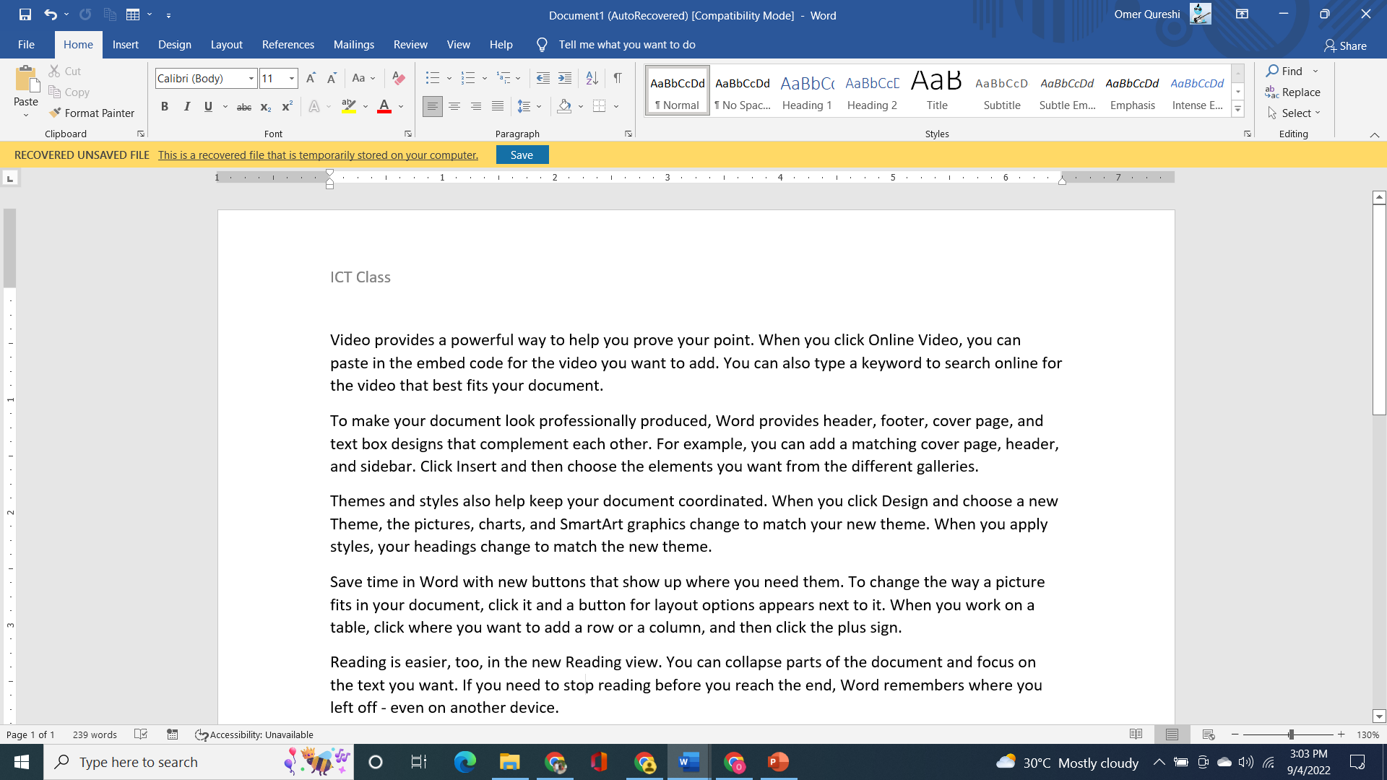
Press Alt + Tab to browse through the various files open on the computer. Let the alt tab go when selecting the window
Quick access toolbar to utilize the most frequently used commands. Right click to modify

Slide 4
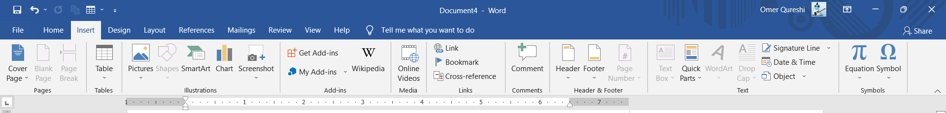
Header and Footer

Slide 5
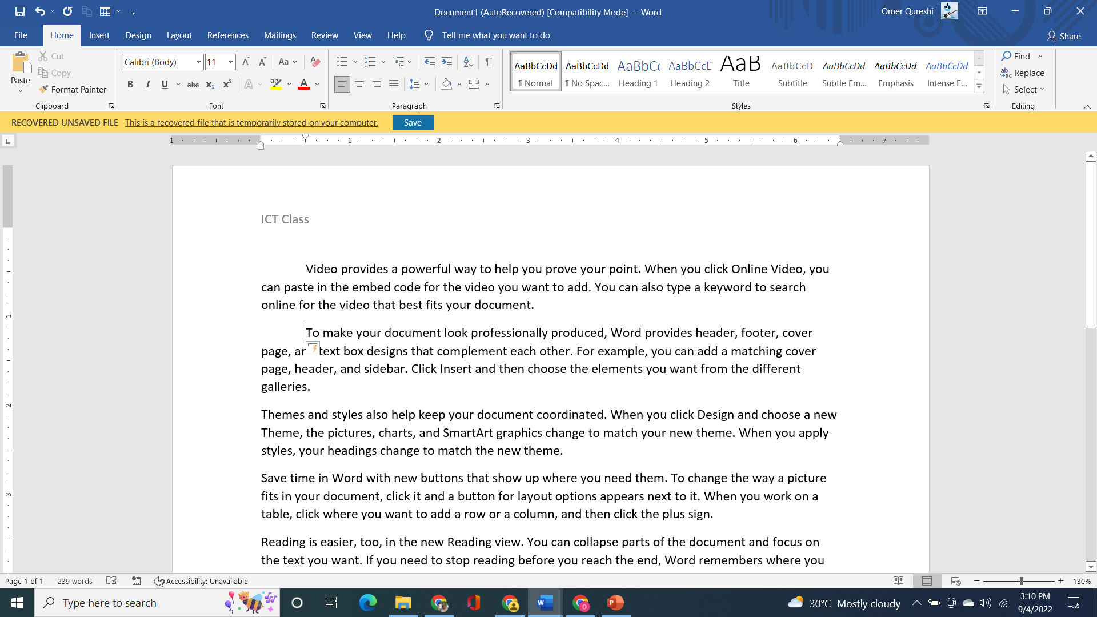
Indentation
Press tab in front of the paragraph

Slide 6

Paragraph formatting and numbering

Slide 7
Rand function
=Rand() function gives 5 paragraphs of 3 lines
=Rand(p,l) where p represents the number of paragraphs and l the number of lines

Slide 8
Table of contents
Make heading1 from Home and then click references => Table of contents

Slide 9
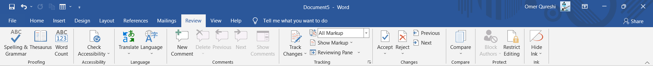
Track changes and comments
Review => Track changes / add comments

Slide 10
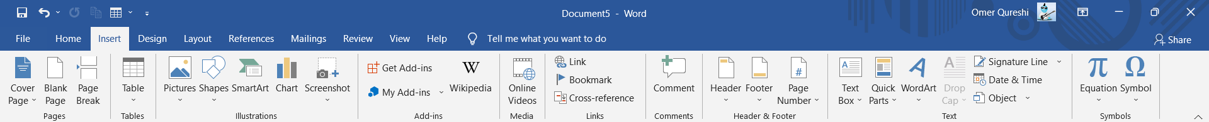
Page Numbers

Slide 11
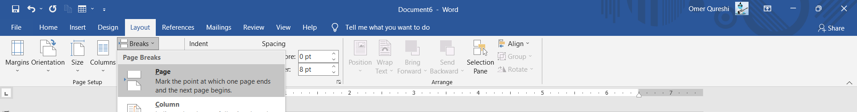
Page break (Breaks the text to another page)
Activate formatting marks: Home->Formatting marks

